Slide 1
Data Visualization for Financial Statements

Slide 2
NUMERICAL ANALYSIS
The mean, standard deviation and median values were calculated.
The mean depicts the average cost associated with each data group.
The standard deviation from the average cost was necessary to account for differences in cost.

Slide 3
The various means are as follows:
Data | Mean
Market Cap(in B USD) | 175.848864
Revenue | 56812.678702
Gross Profit | 27545.814532
Net Income | 8470.150596
Earning Per Share | 0.782511
EBITDA | 14760.361217
Share Holder Equity | 53023.433979
Cash Flow from Operating | 11339.235574
Cash Flow from Investing | -6323.103234

Slide 4
Data | Mean
Cash Flow from Financial Activities | -2087.00
Current Ratio | 1.3224
Debt/Equity Ratio | 0.3164
ROE | 9.8734
ROA | 6.0682
ROI | 7.5468
Net Profit Margin | 11.6899
Free Cash Flow per Share | 0.0651
Return on Tangible Equity | 16.2814
Number of Employees | 106700.0000
Inflation Rate(in US) | 1.6222
Data
Mean

Slide 5
The standard deviation from the mean of the different data is as follows:
Data | Standard deviation
Market Cap(in B USD) | 184.251925
Revenue | 45731.547071
Gross Profit | 20978.010247
Net Income | 11537.243136
Earning Per Share | 4.271091
EBITDA | 17015.476567
Share Holder Equity | 45267.244633
Cash Flow from Operating | 19644.662073
Cash Flow from Investing | 12752.985176
Cash Flow from Financial Activities | 10585.259289

Slide 6
Data | Standard deviation
Current Ratio | 1.518842
Debt/Equity Ratio | 1.468276
ROE | 20.907196
ROA | 7.020664
ROI | 12.373381
Net Profit Margin | 9.585452
Free Cash Flow per Share | 2.164338
Return on Tangible Equity | 171.354353
Number of Employees | 111201.691082
Inflation Rate(in US) | 0.066647

Slide 7
The median value in each data group is:
Data | Median
Market Cap(in B USD) | 108.4800
Revenue | 52708.0000
Gross Profit | 21915.0000
Net Income | 4757.8000
Earning Per Share | 1.4200
EBITDA | 9593.7010
Share Holder Equity | 55865.0000
Cash Flow from Operating | 5865.0000
Cash Flow from Investing | -4714.0000
Cash Flow from Financial Activities | -2087.0000
Current Ratio | 1.3224

Slide 8
Data | Median
Debt/Equity Ratio | 0.3164
ROE | 9.8734
ROA | 6.0682
ROI | 7.5468
Net Profit Margin | 11.6899
Free Cash Flow per Share | 0.0651
Return on Tangible Equity | 16.2814
Number of Employees | 106700.0000
Inflation Rate(in US) | 1.6222

Slide 9
GRAPHICAL ANALYSIS
Histograms, boxplots, a bar plot and a correlation heatmap were used in the graphical analysis
Histograms were used to show the frequency with which values occurred.
Box plots were used as they depict outliers in data.
The bar plot was used as it compares the values between years in an easily interpretable way.
The correlation Heatmap was used as it shows the degree of correlation between figures.

Slide 10
HISTOGRAMS

Slide 11
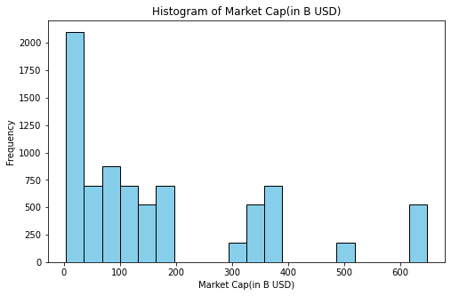
Histogram of Market Cap(in B USD)

Slide 12
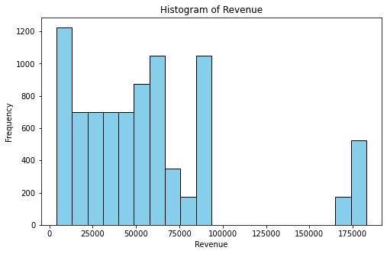
Histogram of Revenue

Slide 13
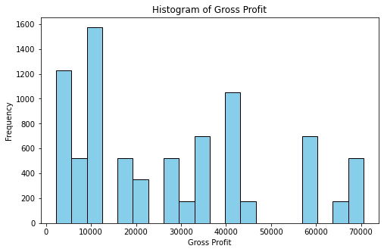
Histogram of Gross Profit

Slide 14
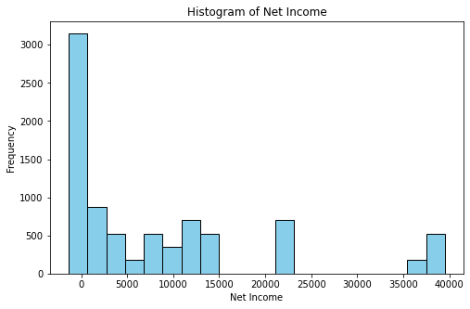
Histogram of Net Income

Slide 15
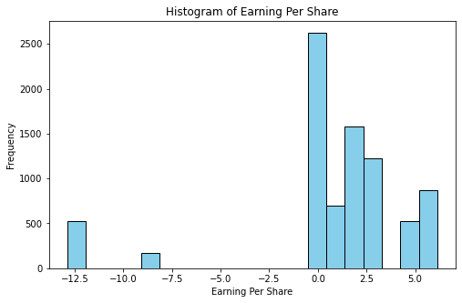
Histogram of Earning Per Share

Slide 16
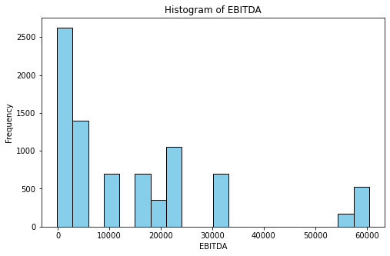
Histogram of EBITDA

Slide 17
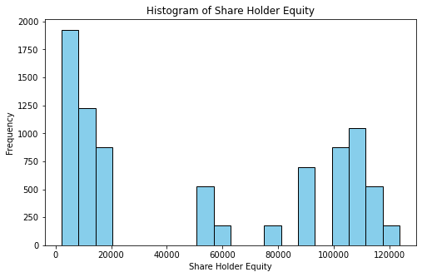
Histogram of Share Holder Equity

Slide 18
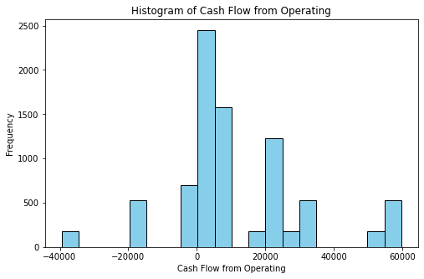
Histogram of Cash Flow from Operating

Slide 19
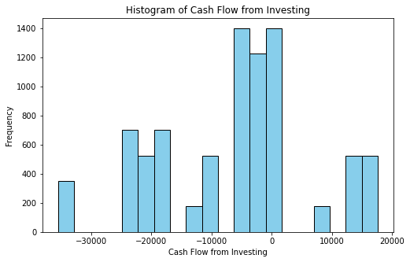
Histogram of Cash Flow from Investing

Slide 20
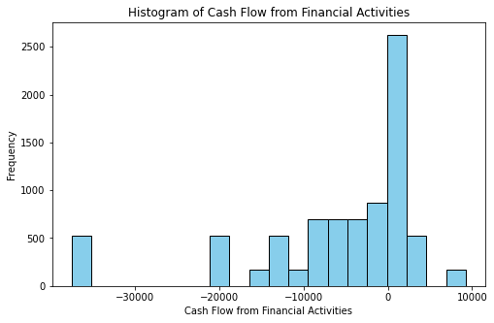
Histogram of Cash Flow from Financial Activities

Slide 21
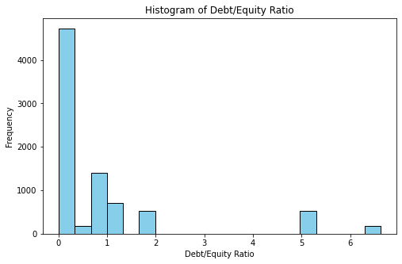
Histogram of Debt/Equity Ratio

Slide 22
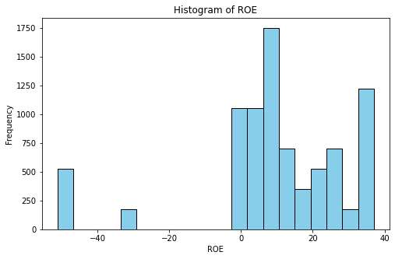
Histogram of ROE

Slide 23
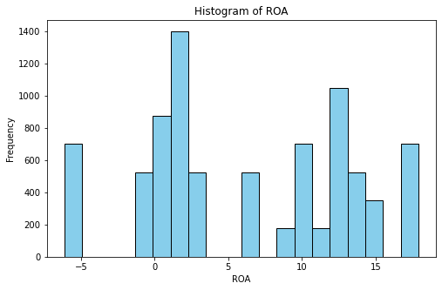
Histogram of ROA

Slide 24
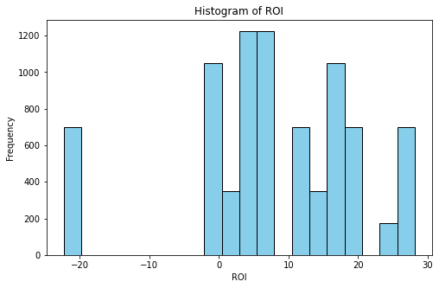
Histogram of ROI

Slide 25
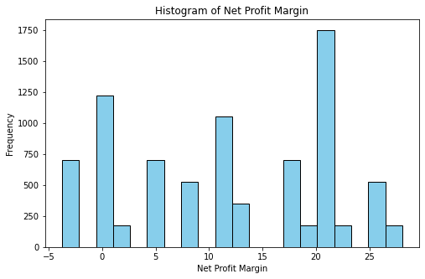
Histogram of Net Profit Margin

Slide 26
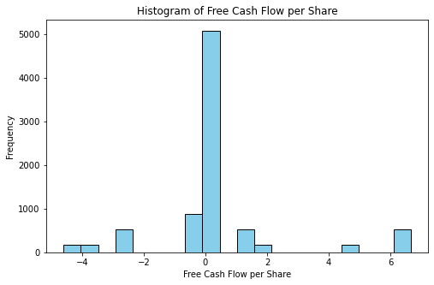
Histogram of Free Cash Flow per Share

Slide 27
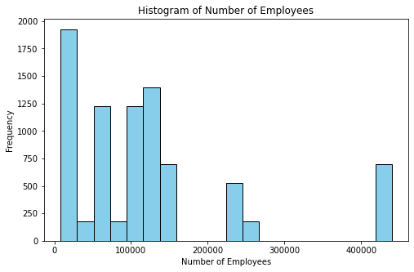
Histogram of Number of Employees

Slide 28
BOX PLOTS

Slide 29
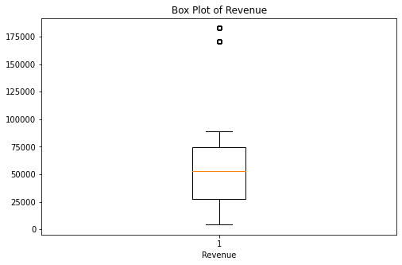
Box Plot of Revenue

Slide 30
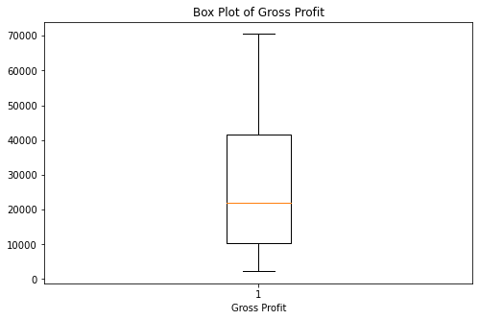
Box Plot of Gross Profit

Slide 31
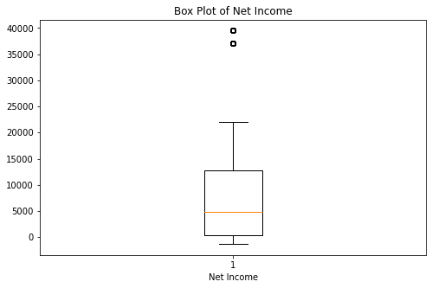
Box Plot of Net Income

Slide 32
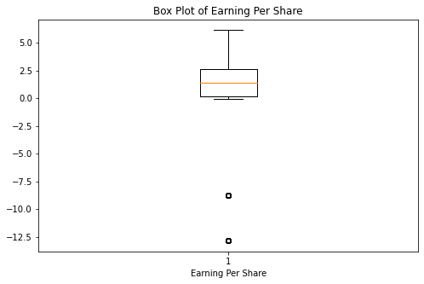
Box Plot of Earning Per Share

Slide 33
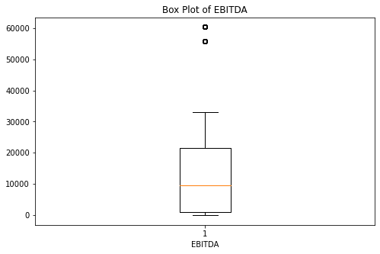
Box Plot of EBITDA

Slide 34
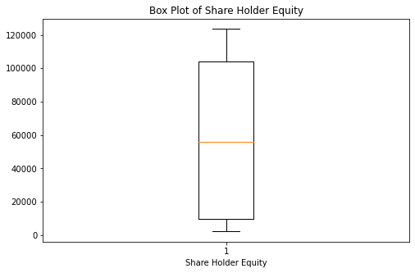
Box Plot of Share Holder Equity

Slide 35
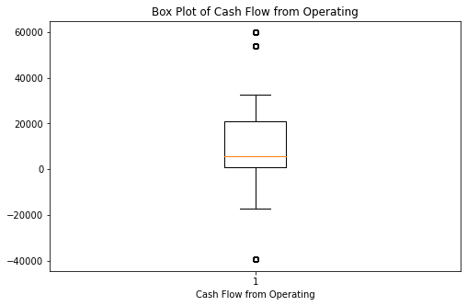
Box Plot of Cash Flow from Operating

Slide 36
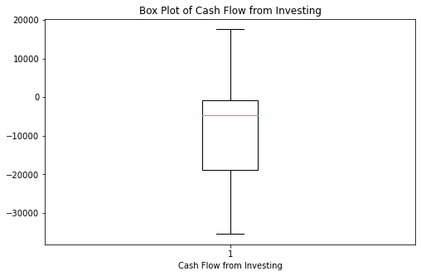
Box Plot of Cash Flow from Investing

Slide 37
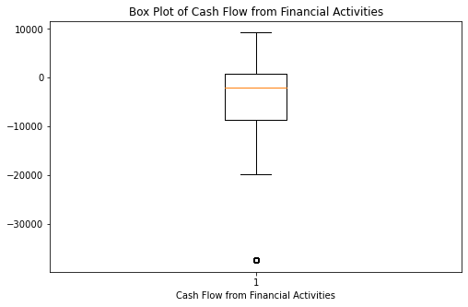
Box Plot of Cash Flow from Financial Activities

Slide 38
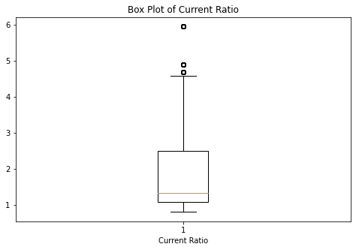
Box Plot of Current Ratio

Slide 39
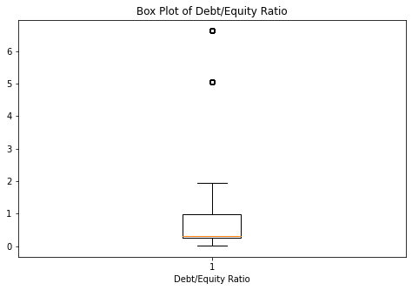
Box Plot of Debt/Equity Ratio

Slide 40
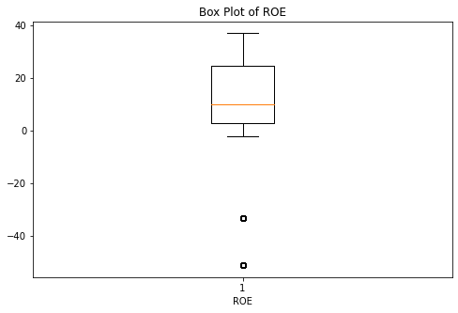
Box Plot of ROE

Slide 41
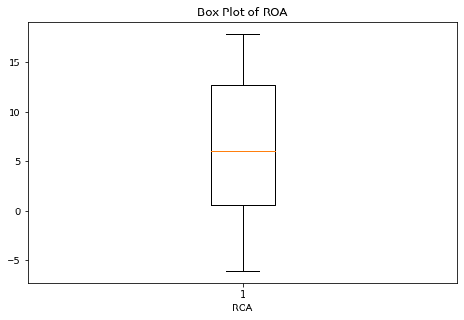
Box plot of ROA

Slide 42
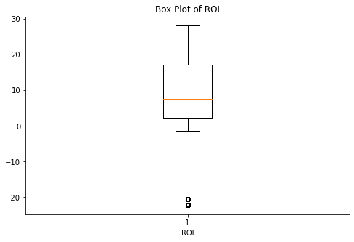
Box Plot of ROI

Slide 43
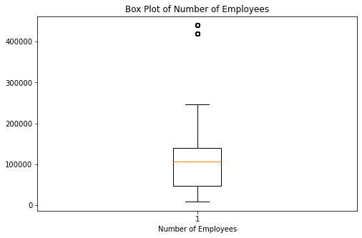
Box plot of number of employees

Slide 44
BAR GRAPH

Slide 45
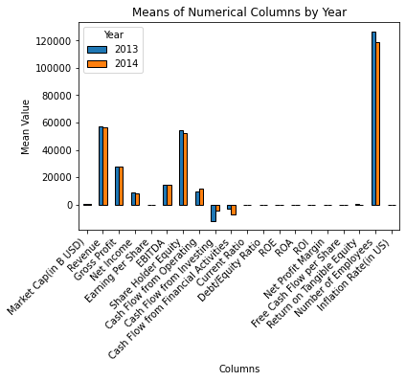
Bar Graph Comparing Means Of Numerical Data Of The Years 2013 And 2014

Slide 46
CORRELATION HEAT MAP

Slide 47
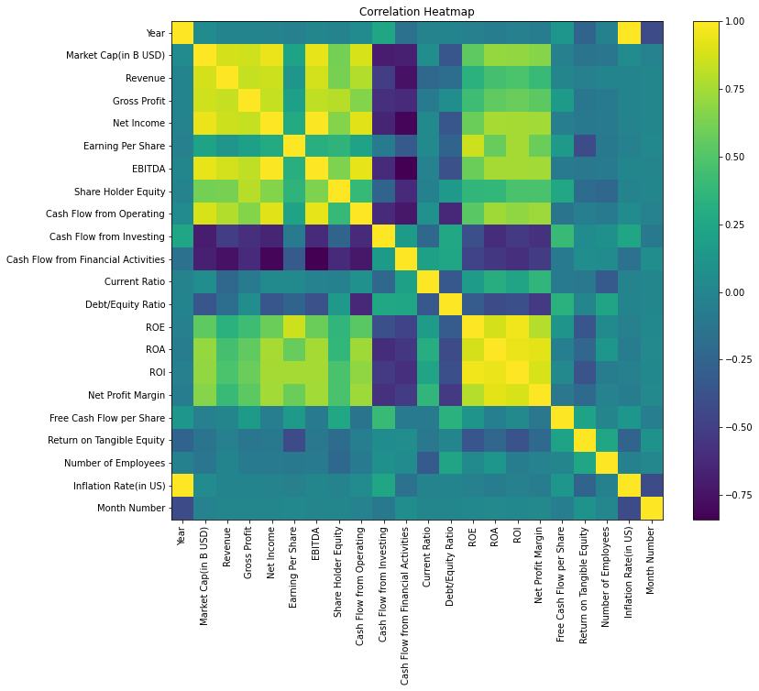
Correlation Heatmap

Slide 48
Correlation Heatmap Interpretation
This correlation heatmap visualizes the relationships between various financial metrics and indicators.
The colours range from dark purple, indicating a strong negative correlation
to dark green, indicating a strong positive correlation.
Lighter colours represent weaker correlations.
For example, there is a strong positive correlation between EBITDA and Gross Profit as indicated by the dark green colour.

